Slide 1
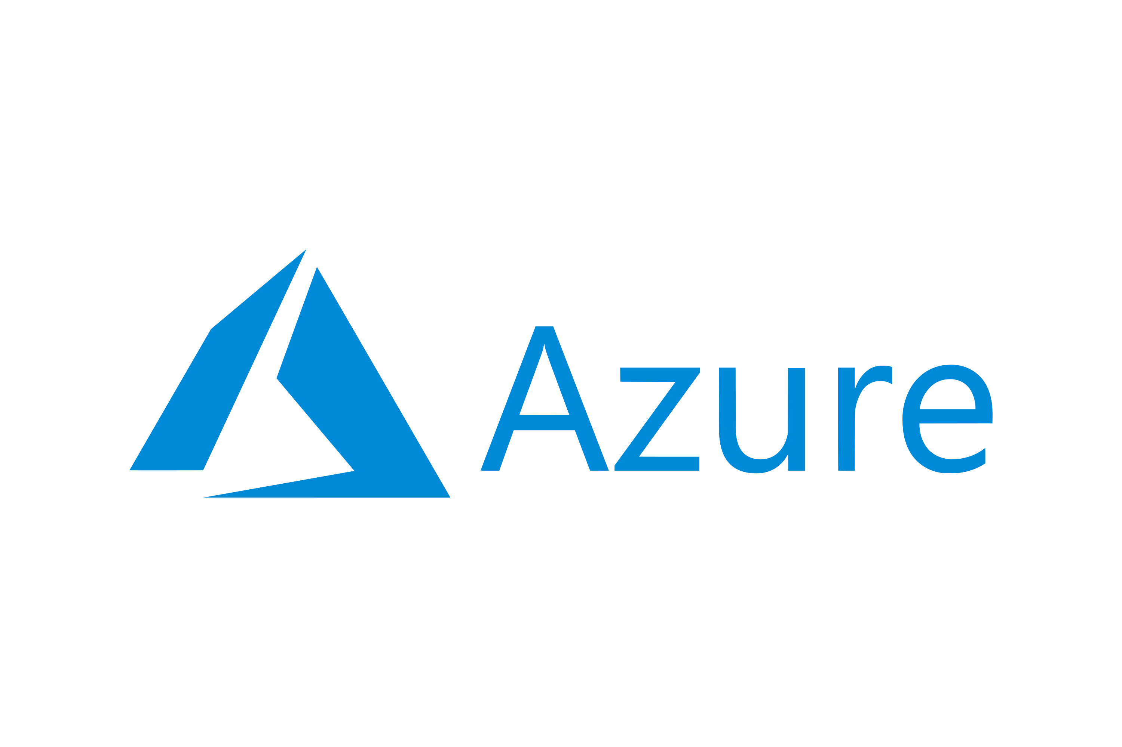

Migrate your On-Premises
TO

Slide 2
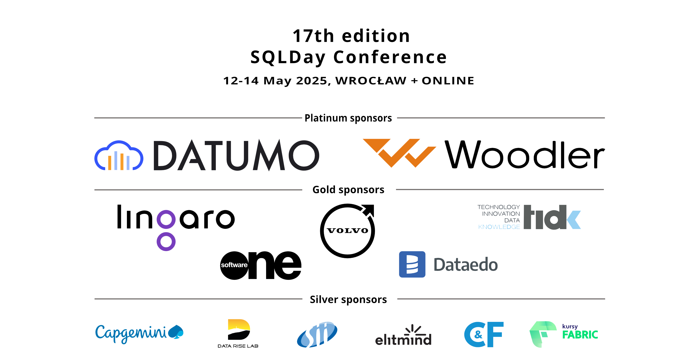

Slide 3


EDWIN
SARMIENTO
Microsoft MVP/Microsoft Certified Master: SQL Server
https://LearnSQLServerHADR.com
edwin@EdwinMSarmiento.com
@EdwinMSarmiento
http://ca.linkedin.com/in/EdwinMSarmiento

Slide 4


Slide 5


Slide 6
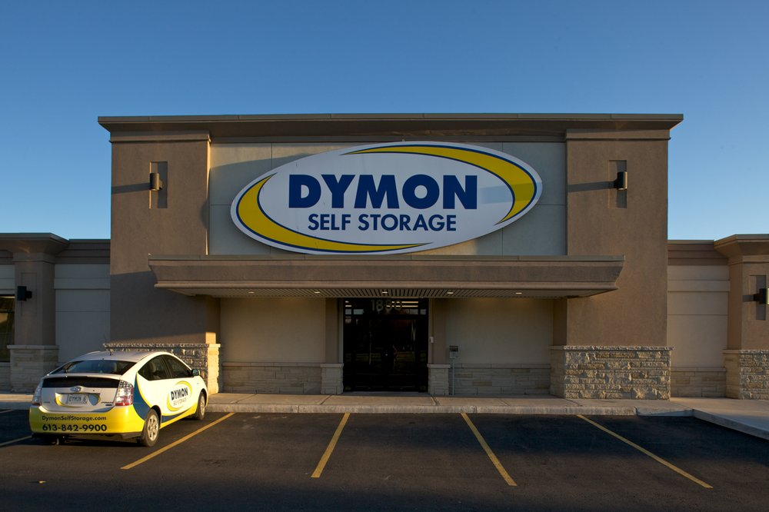

Slide 7
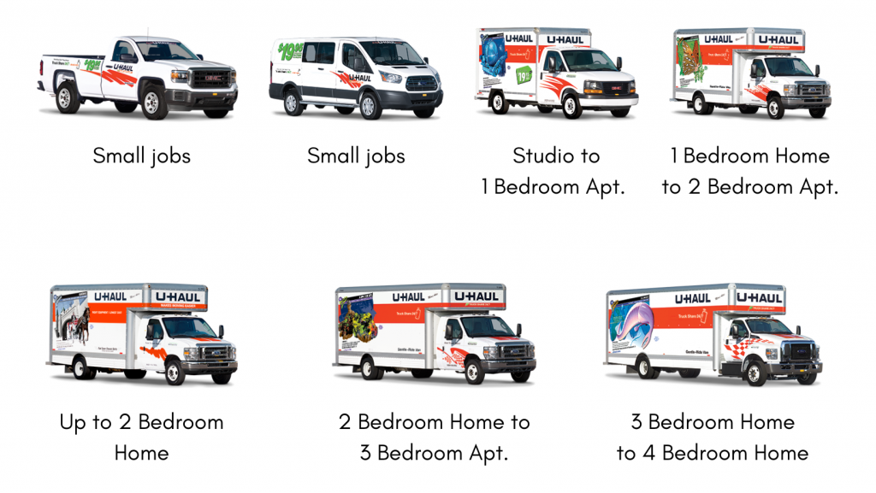
*U-Haul DID NOT SPONSOR this slide

Slide 8
Migrating SQL Server to Azure
1
Planning
Considerations
Tools & Strategies
Resources
2
3
4

Slide 9
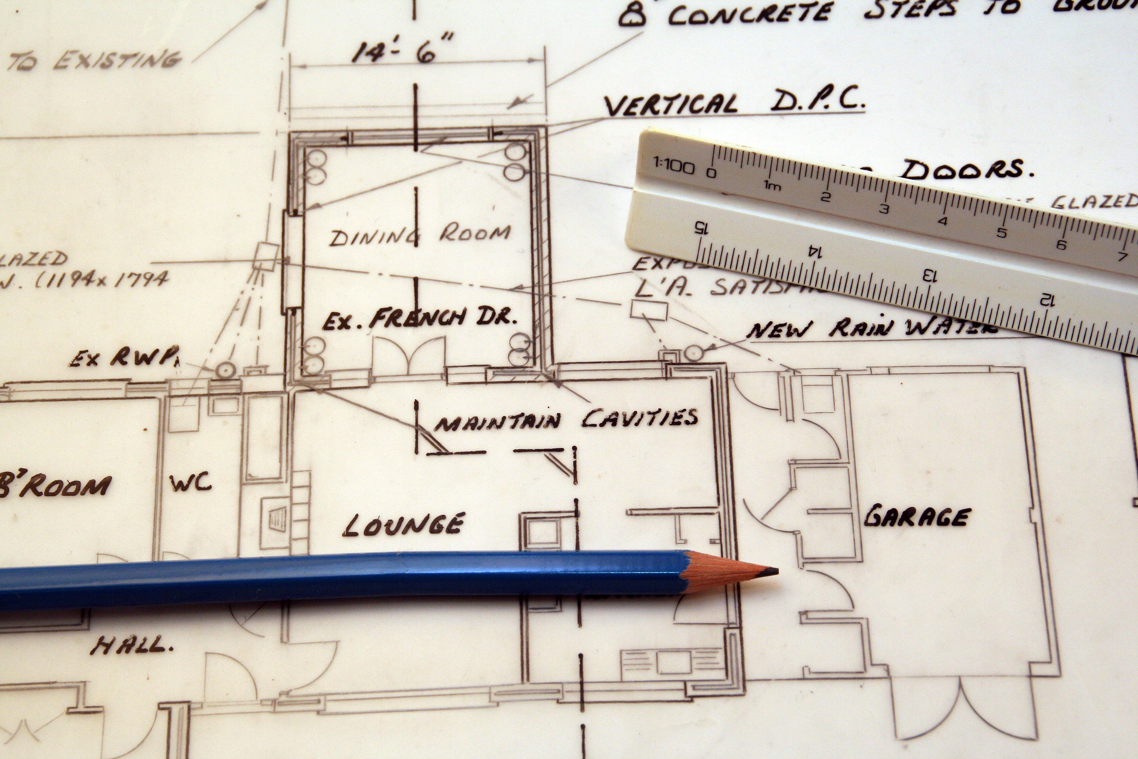
1
Planning

Slide 10

“
Those who PLAN do better than those who do not plan
even though they rarely stick to their plan.
- Winston Churchill -

Slide 11




zure SQL
The family of SQL cloud databases
Platform-as-a-Service PaaS
Infrastructure-as-a-Service IaaS
Azure SQL Database
Azure SQL Managed Instance
SQL Server on Azure Virtual Machines

Slide 12

Platform-as-a-Service PaaS
Infrastructure-as-a-Service IaaS
ADMINISTRATION

Slide 13
Platform-as-a-Service PaaS
Infrastructure-as-a-Service IaaS
logical control
physical control*
ADMINISTRATION

Slide 14

Platform-as-a-Service PaaS
Infrastructure-as-a-Service IaaS
COST

Slide 15
Platform-as-a-Service PaaS
Infrastructure-as-a-Service IaaS
bandwidth pricing
backup retention
additional IOPS
licensing
compute
storage
administration
COST

Slide 16
Platform-as-a-Service PaaS
Infrastructure-as-a-Service IaaS
SERVICE LEVEL AGREEMENT

Slide 17
Platform-as-a-Service PaaS
Infrastructure-as-a-Service IaaS
99.995%
Azure SQL Database
99.9%*
virtual machine-level
99.99%
Azure SQL Managed Instance
SERVICE LEVEL AGREEMENT

Slide 18
Platform-as-a-Service PaaS
Infrastructure-as-a-Service IaaS
new deployments
SaaS-based design
require tight control
use existing features
?
which one

Slide 19
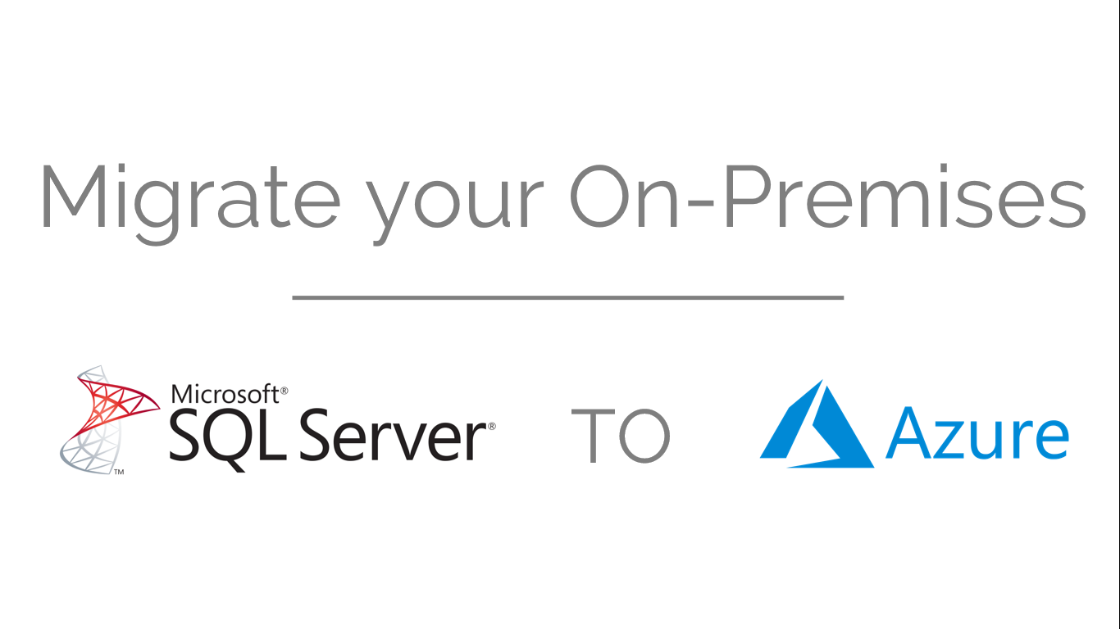
or
SQL Server on Azure Virtual Machines
Azure SQL Managed Instance
VM sizes
General Purpose vs Business Critical

Slide 20


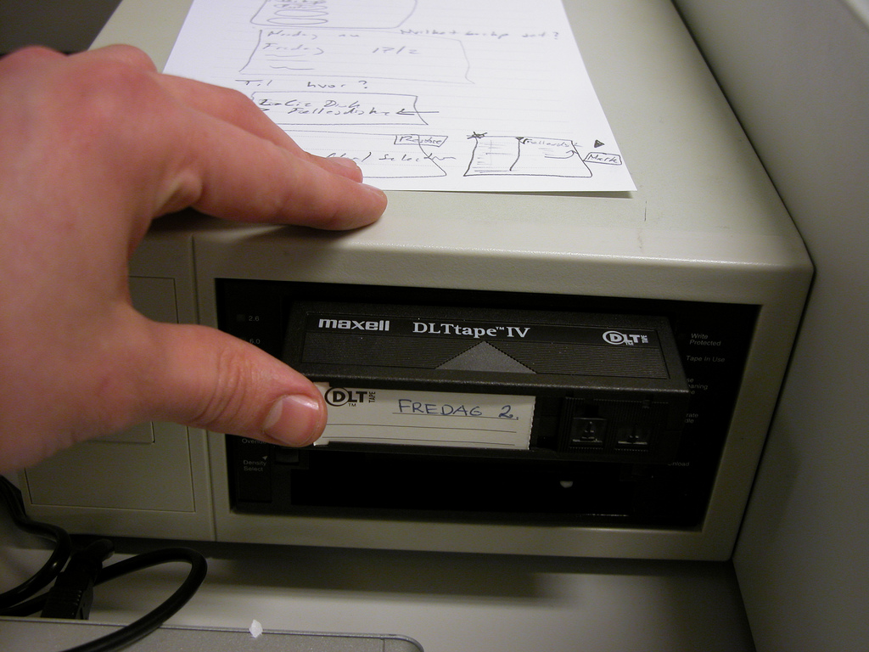

Documentation
Strategy
Backup/Rollback
Testing

Slide 21
Migration Project Timeline
Pre-Migration
Pre-Migration
Post-Migration
1
2
3
4
Start
End
Actual Migration
Stabilize
Stabilize

Slide 22
“
PPT
manifesto

Slide 23
PROCESS
a PROPERLY DEFINED PROCESS

Slide 24
PEOPLE
a COHESIVE TEAM

Slide 25
TECHNOLOGY
a PLATFORM THAT MEETS THE REQUIREMENTS

Slide 26

P.D.A principle

Slide 27

IDENTIFY & PRIORITIZE the workloads that you need to migrate based on REQUIREMENTS
1
Prioritize

Slide 28
not all workloads are created EQUAL

Slide 29
DEV/STG/PROD
not all workloads are created EQUAL
RPO/RTO/SLA

Slide 30
decide on the BEST SOLUTION & STRATEGY
based on the results of the discovery
from the previous phase
2
Decide
Notes:
https://www.flickr.com/photos/78749146@N06/13455563693

Slide 31

IN SOURCE vs OUTSOURCE
some vs ALL databases
BUDGET
Upgrade vs Migrate vs BOTH
set expectations
- issue resolution before migration -
- validation after migration -
Azure VMs vs Azure SQL MI
Notes:
Photo by Vladislav Babienko on Unsplash

Slide 32

move towards the direction of your decisions
3
Act
Notes:
https://www.flickr.com/photos/78749146@N06/13455563693

Slide 33

define operational procedures
define
migration
strategy
issue resolution and escalation
implement the solution
train staff
implement monitoring
Notes:
Photo by Jakob Owens on Unsplash

Slide 34
2
Considerations

Slide 35

CONSIDERATIONS
Are you moving your apps to Azure?
APPLICATIONS
Notes:
https://flic.kr/p/aN2jp6
https://flic.kr/p/4cVbiH

Slide 36
CONSIDERATIONS
How will they CONNECT?
APPLICATIONS
Notes:
https://flic.kr/p/aN2jp6
https://flic.kr/p/4cVbiH

Slide 37
CONSIDERATIONS
How will they AUTHENTICATE?
APPLICATIONS
Notes:
https://flic.kr/p/aN2jp6
https://flic.kr/p/4cVbiH

Slide 38
CONSIDERATIONS
What about
APP COMPATIBILITY?
APPLICATIONS
Notes:
https://flic.kr/p/aN2jp6
https://flic.kr/p/4cVbiH

Slide 39

CONSIDERATIONS
POST-MIGRATION
How will you MONITOR?
*Are your monitoring tools supported on Azure?
OPERATIONS
Notes:
https://flic.kr/p/aN2jp6
https://flic.kr/p/4cVbiH

Slide 40
CONSIDERATIONS
POST-MIGRATION
How will you deal with BACKUPS?
OPERATIONS
Azure SQL Managed Instance vs SQL Server on Azure VM
Notes:
https://flic.kr/p/aN2jp6
https://flic.kr/p/4cVbiH

Slide 41
CONSIDERATIONS
POST-MIGRATION
How will you RESOLVE & MANAGE ISSUES?
OPERATIONS
*How will your escalation procedures look like?
Notes:
https://flic.kr/p/aN2jp6
https://flic.kr/p/4cVbiH

Slide 42
CONSIDERATIONS
POST-MIGRATION
How will you deal with CHANGE MANAGEMENT?
OPERATIONS
Notes:
https://flic.kr/p/aN2jp6
https://flic.kr/p/4cVbiH

Slide 43
CONSIDERATIONS
POST-MIGRATION
How will you deal with MAINTENANCE?
OPERATIONS
Azure SQL Managed Instance vs SQL Server on Azure VM
Notes:
https://flic.kr/p/aN2jp6
https://flic.kr/p/4cVbiH

Slide 44

3
Tools
&
Strategies

Slide 45

MAP Toolkit*
Azure Migrate
Data
Migration Assistant
……
…………………
*Azure
Data
Studio
………………
…………………
dbaTools

Slide 46
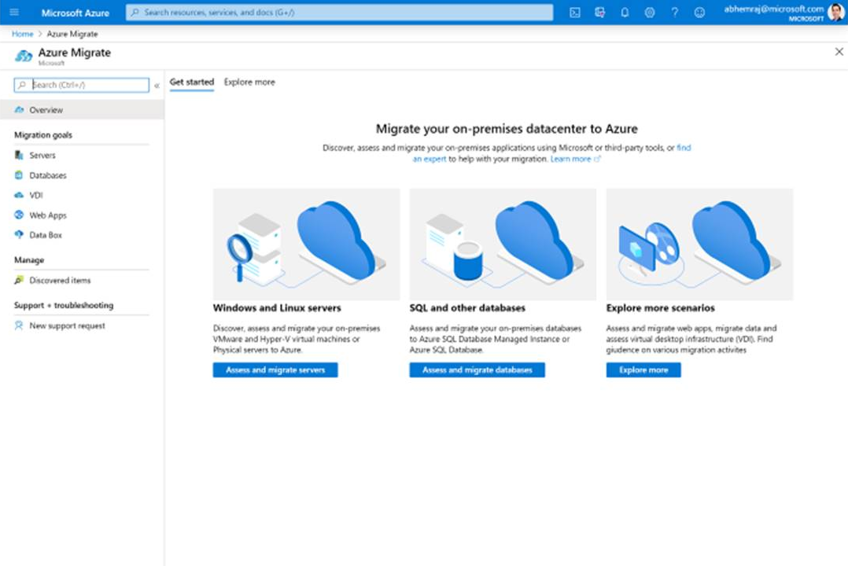
Azure Migrate
assessment, migration, and modernization

Slide 47
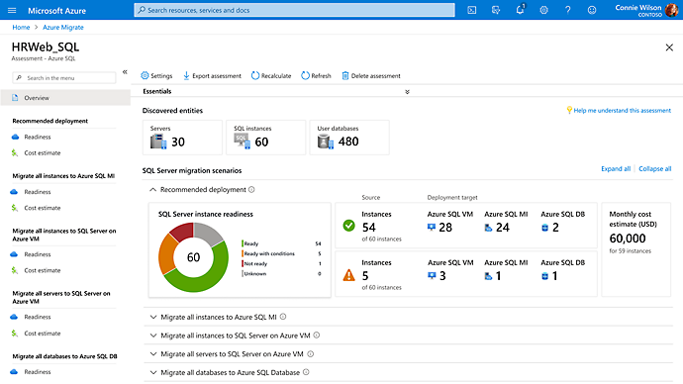
Azure Migrate
assessment, migration, and modernization

Slide 48
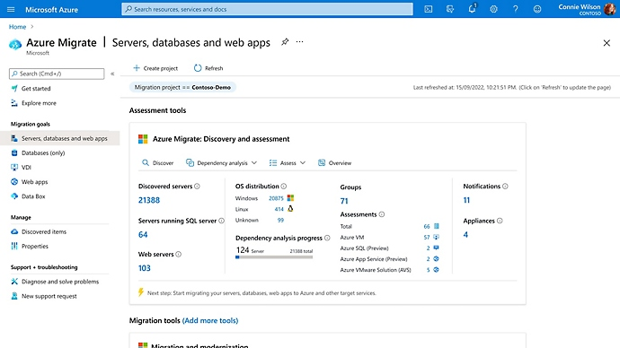
Azure Migrate
assessment, migration, and modernization

Slide 49
dbatools
Backup-DbaDatabase
Notes:
https://www.flickr.com/photos/78749146@N06/13455563693

Slide 50
dbatools
Restore-DbaDatabase
Notes:
https://www.flickr.com/photos/78749146@N06/13455563693

Slide 51
dbatools
Start-DbaMigration
Notes:
https://www.flickr.com/photos/78749146@N06/13455563693

Slide 52
4
Resources

Slide 53
Resources
Microsoft Assessment and Planning (MAP) Toolkit
http://www.microsoft.com/en-us/download/details.aspx?id=7826
Data Migration Assistant
https://learn.microsoft.com/en-us/sql/dma/dma-overview?view=sql-server-ver16
dbatools
https://dbatools.io/
Azure Migrate
https://azure.microsoft.com/en-us/products/azure-migrate

Slide 54
EDWIN
SARMIENTO
Microsoft MVP/Microsoft Certified Master: SQL Server
https://www.EdwinMSarmiento.com
edwin@EdwinMSarmiento.com
@EdwinMSarmiento
http://ca.linkedin.com/in/EdwinMSarmiento

